Slide 1
Metamodel team
2014 Summit Update

Slide 2
Roadmap
OMG WP
OMG RFP
ETC
3/15
BIZBOK® WP
BIZBOK® Updates
Ongoing Vendor Engagement
We have multiple threads that the team is trying to pursue. First and foremost, is the OMG White Paper. The BA MetaModel Team’s responsibility is to provide a working group BASIG in the OMG with guidance and thought leadership to justify the need for a BA MetaModel standard.

Slide 3
Roadmap (Detailed Breakdown)
OMG White Paper to justify a BA MetaModel (drafted by BASIG)
Deliverable (List of Bullet Points)
List of Scenarios (to support the Bullets)
Draft review (part of the BAsig effort)
Team review of Draft
Finalize deliverable by EOM January
Present at March meeting for Guild
BA MetaModel for the RFP
Deliverable (RFP Document + “neutral” BA MetaModel)
Draft BA MetaModel (expand on OMG WP)
Draft RFP Document
Team review of Draft BA MetaModel
BIZBOK® White Paper to introduce and position MM for BIZBOK®
Deliverable (White Paper + BIZBOK® MM)
Draft White Paper (What, Why, Where, How)
Team review of draft outline
Bullet Points (per OMG White Paper)
Draft updated BIZBOK® MM
Present at March meeting for Guild
BIZBOK™ Section 5.1 Update
Draft section to align with BIZBOK® WP
Include reference to align with other MMs
Include reference to scenarios
Vendor Collaboration
Setup initial meeting with vendor representatives
Establish ongoing cadence with tool vendors

Slide 4
Scenarios for the OMG WP
List of Scenarios
Helps align the “enterprise” vocabulary across the organization to promote “understanding” across the organization (across value streams ?) | Shift to Customer-Centric Business Model | Joint Venture Development
Provides a solid foundation for launching or extending data governance program | Strategy Development and Execution | Globalization
Helps drive consistency amongst the vendor community (reduces integration challenge and minimizes risk of vendor lock-in) | Change Management | Agile Strategic Planning
Driving software and system requirements from business architecture (also driving software testing from same) | Merger and Acquisition Analysis | Operational Cost Reduction
Enables consistency check and alignment across the organization & value streams | Governance | Supply Chain Streamlining
Ensures the enterprise modeling is driven and aligned by the business (not IT) | Risk & Compliance | Investment Analysis
Helps ensure initiatives are better aligned and coordinated. And within one or more portfolios, the business has a better opportunity to prioritize the right initiatives | End-2-End capability to inform impact analysis | New Product / Service Rollout
Provides visibility to align strategy with execution | Divestiture | Business Capability Outsourcing
 |  | Ensures interoperability can scale

Slide 5
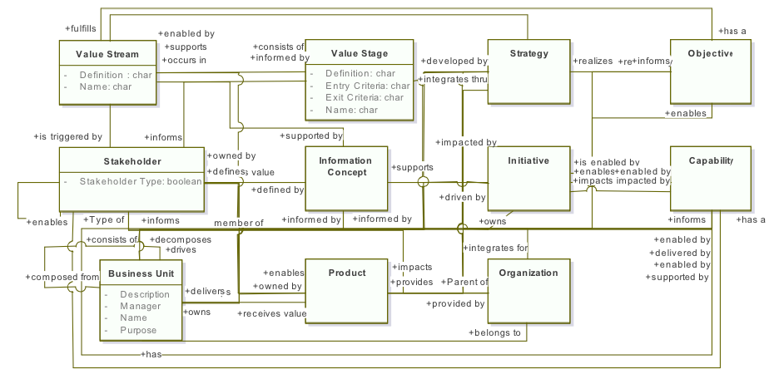
Current state BA MetaModel (bizbok®)

Slide 6
Thank you
We are looking for additional participants to accelerate
our efforts on this landmark work plan. Please contact the
Team Leader (Jeffrey Wallk) on the Guild Site (see link)
(http://www.businessarchitectureguild.org)

